Slide 1
Long distance coupling between two SRRs
Yutong Zhao
2018 Oct 29th

Slide 2
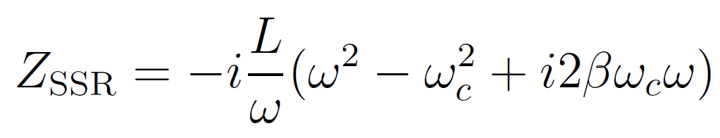

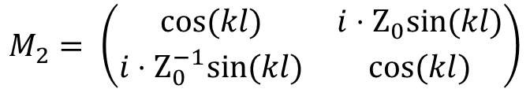

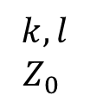

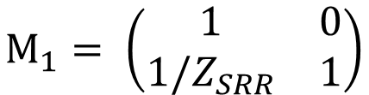
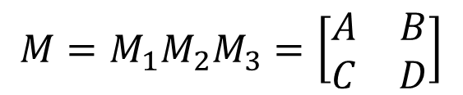


RLC model
$$k,l$$
$$Z_{0}$$
$$Z_{SRR}$$
$$Z_{SRR}$$
Phase Shifter
SRR-1
SRR-2
$$ΔΦ=βΔl$$
SRR-2 = SRR-1
$$M_{1}= \left(\begin{matrix}1 & 0 \\ 1/Z_{SRR} & 1\end{matrix}\right)$$
$$M_{2}= \left(\begin{matrix}cos⁡(kl) & i⋅Z_{0}sin⁡(kl) \\ i⋅Z_{0}^{−1}sin⁡(kl) & cos⁡(kl)\end{matrix}\right)$$
$$M_{3}=M_{1}$$
$$M=M_{1}M_{2}M_{3}=\left[\begin{matrix}A & B \\ C & D\end{matrix}\right]$$

Slide 3
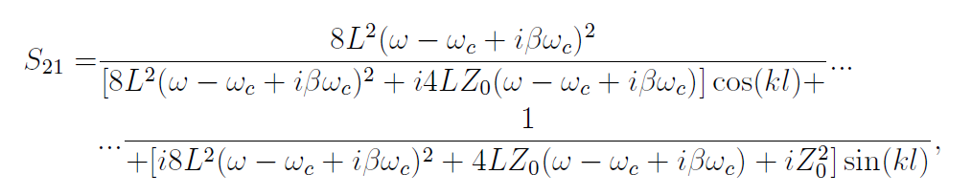
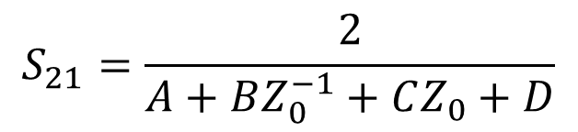
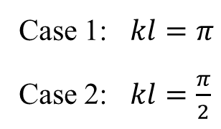
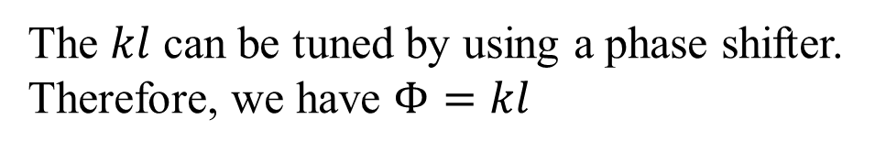
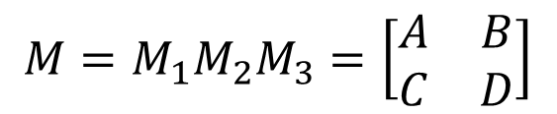
RLC model (2)
$$M=M_{1}M_{2}M_{3}=\left[\begin{matrix}A & B \\ C & D\end{matrix}\right]$$
$$S_{21}=\frac{2}{A+BZ_{0}^{−1}+CZ_{0}+D}$$
Case 1: $kl=π$
Case 2: $kl=\frac{π}{2}$
The $kl$ can be tuned by using a phase shifter.
Therefore, we have $Φ=kl$

Slide 4
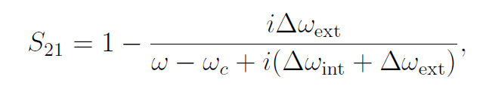

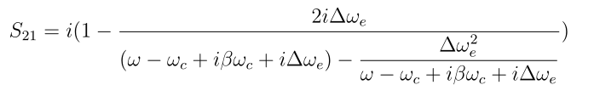



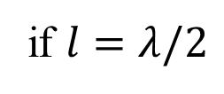

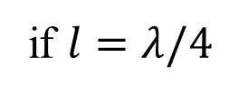
Transmissions
For single SRR
$$Z_{SSR}$$
if $l=λ/2$
$$Z_{SSR}$$
$$β,l$$
$$Z_{0}$$
$$Z_{SSR}$$
if $l=λ/4$

Slide 5
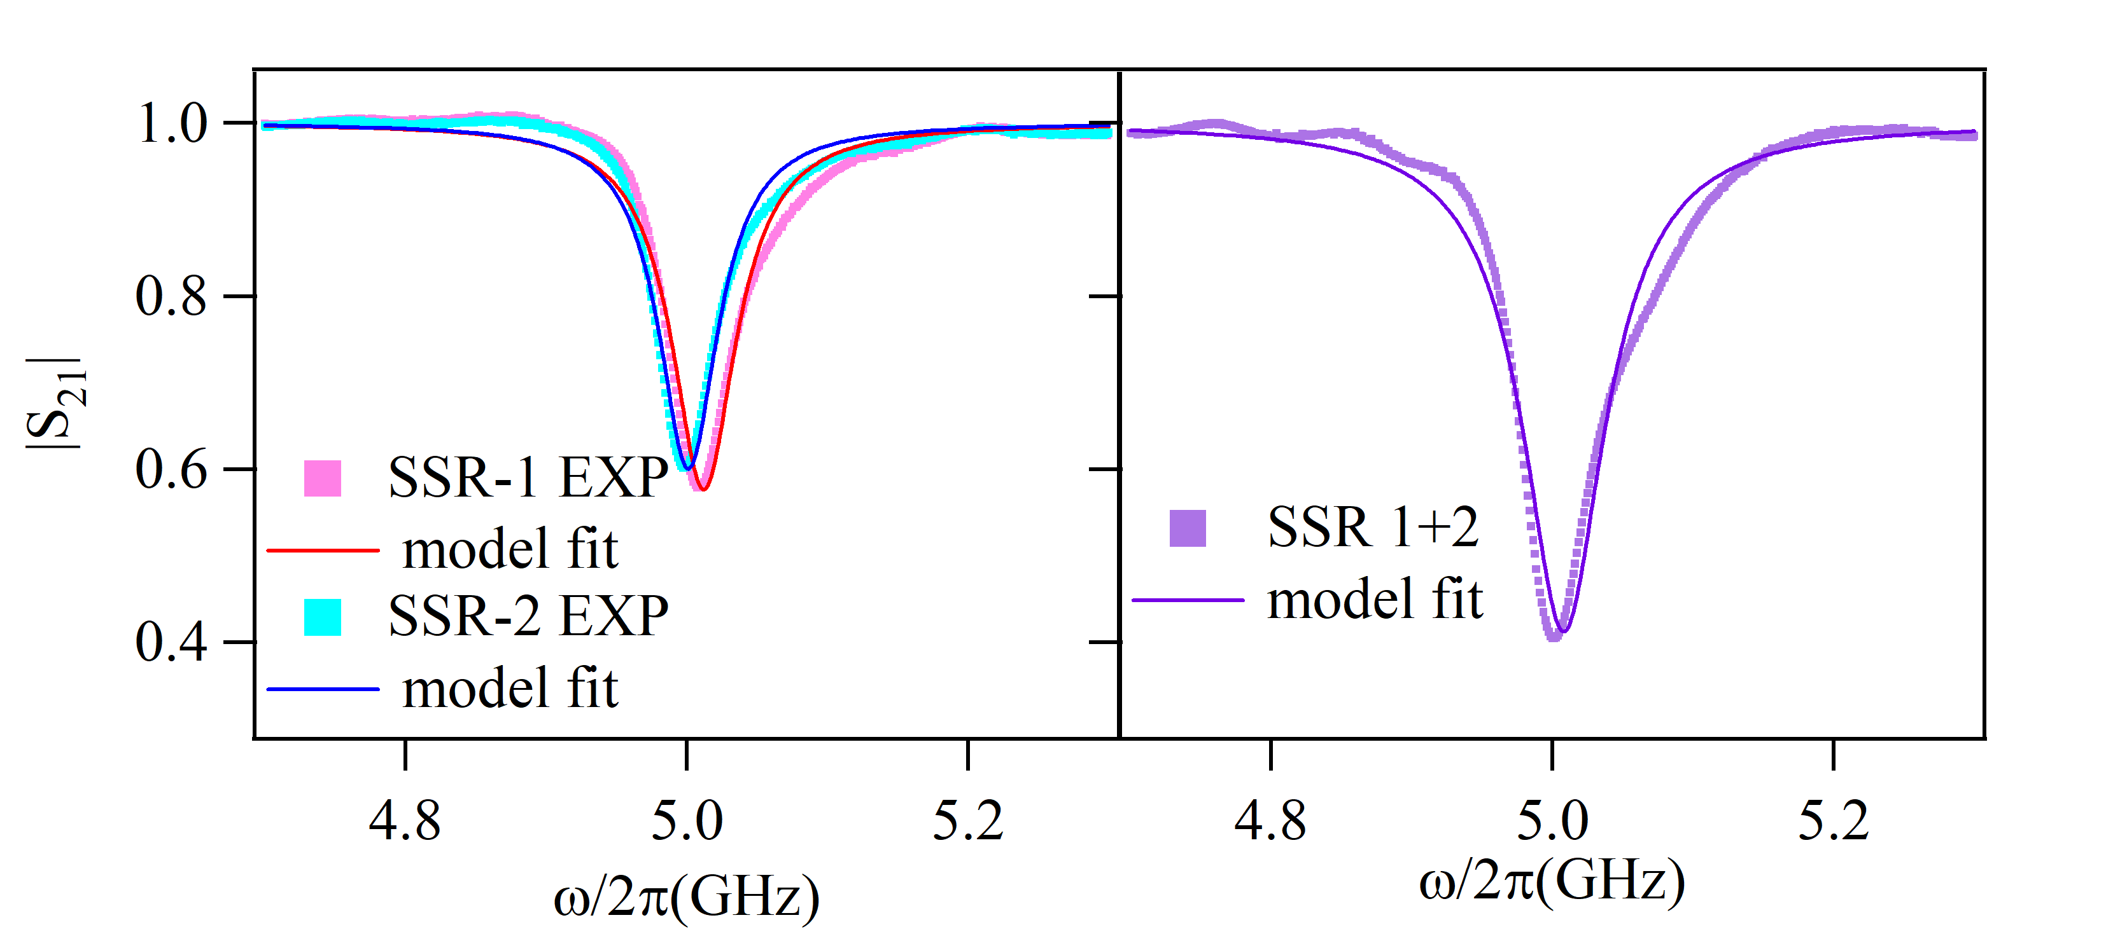
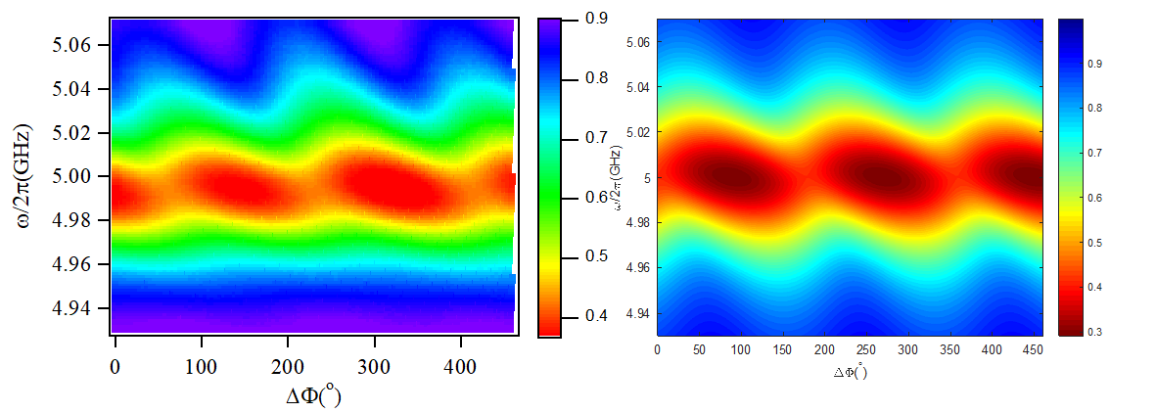
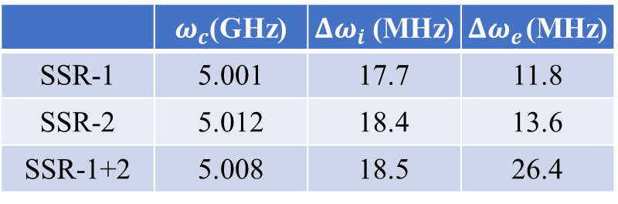


Experiments
 | $ω_{c}$(GHz) | $Δω_{i}$(MHz) | $Δω_{e}$(MHz)
SSR-1 | 5.001 | 17.7 | 11.8
SSR-2 | 5.012 | 18.4 | 13.6
SSR-1+2 | 5.008 | 18.5 | 26.4
$$S_{21}$$
$$S_{21}$$

